Slide 1
Vrinda Store Annual Report 2022

Slide 2
Objective :-
Vrinda store wants to create an annual sales report for 2022. So that, Vrinda can understand their customers and grow more sales in 2023.

Slide 3
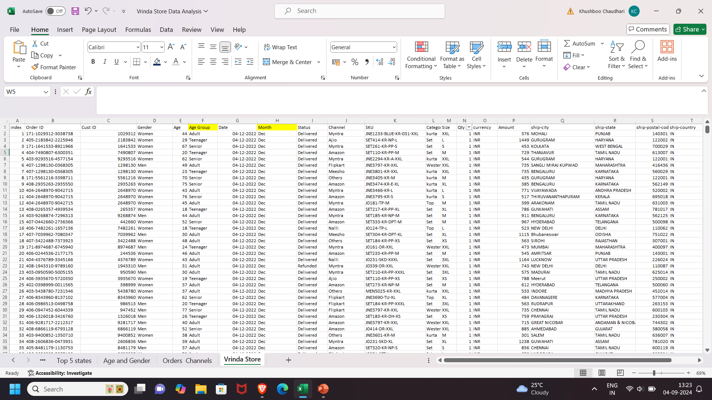
Vrinda Stores Data Set

Slide 4
Questions:-
Compare the sales and orders using single chart
Which month got the highest sales and orders?
Who purchased more- men or women in 2022?
What are different order status in 2022?
List top 5 states contributing to the sales?
Relation between age and gender based on number of orders
Which channel is contributing to maximum sales?
Highest selling category?

Slide 5
Data Cleaning
Gender: Values were initially represented as "M" and "F". These have been standardized to "Male" and "Female".
Quantities: Values of "one" and "two" were replaced with "1" and "2", respectively.

Slide 6
Data Preprocessing
Age Groups: We have created a new column, "Age Group," to categorize individuals based on their age.
Conditions:
If age is greater than or equal to 50, the individual is classified as "Senior."
If age is greater than or equal to 30 but less than 50, the individual is classified as "Adult."
If age is less than 30, the individual is classified as "Teenager.“
Month Extraction: We have extracted the month from a "Date" column.

Slide 7
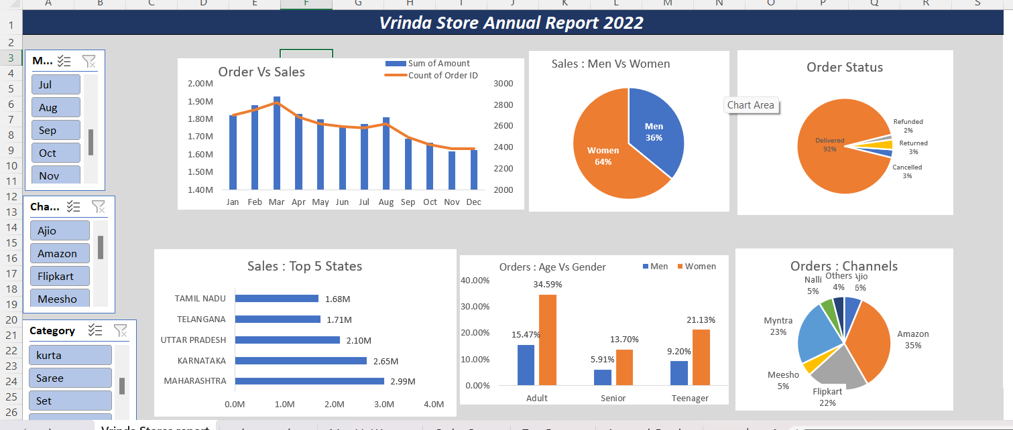
Dashboard Report

Slide 8
Insights
Women are more likely to buy compared to men (~65%)
Maharashtra, Karnataka and Uttar Pradesh are the top 3
Adult age group (30 – 49 Yrs) is max contributing (~50%)
Amazon, Flipkart and Myntra channels are max contributing(~80%)
Final Conclusion to improve Vrinda store sales:
Target women customers of age group (30-49 yrs) living in Maharashtra, Karnataka and Uttar Pradesh by showing ads/offers/coupons available on Amazon, Flipkart and Myntra
Thank You

